Slide 1
Three-phase strategy for the OSD learning method in RBF neural networks
PRIYANKA S. BHESKE (MA23M019 )
MONIKA GUPTA (MA24M016)
March 11,2025

Slide 2
What is an RBFNN?
RBFNN stands for Radial Basis Function Neural Network, which is a type of neural network used for tasks like classification and regression (making predictions based on data).
It has three layers:
Input Layer: This is where the data comes in. It contains several input neurons (features) that represent the data points.
Hidden Layer: This layer has special units called Radial Basis Function (RBF) units. These units process the input data in a way that transforms it into a higher-dimensional space.
Output Layer: This layer gives the final prediction or output based on the transformed data.
Notes:
It’s a type of neural network that helps us predict things or classify data (like sorting emails into spam or not spam). It’s used in many tasks such as predicting prices, identifying objects, or even classifying data.

Slide 3
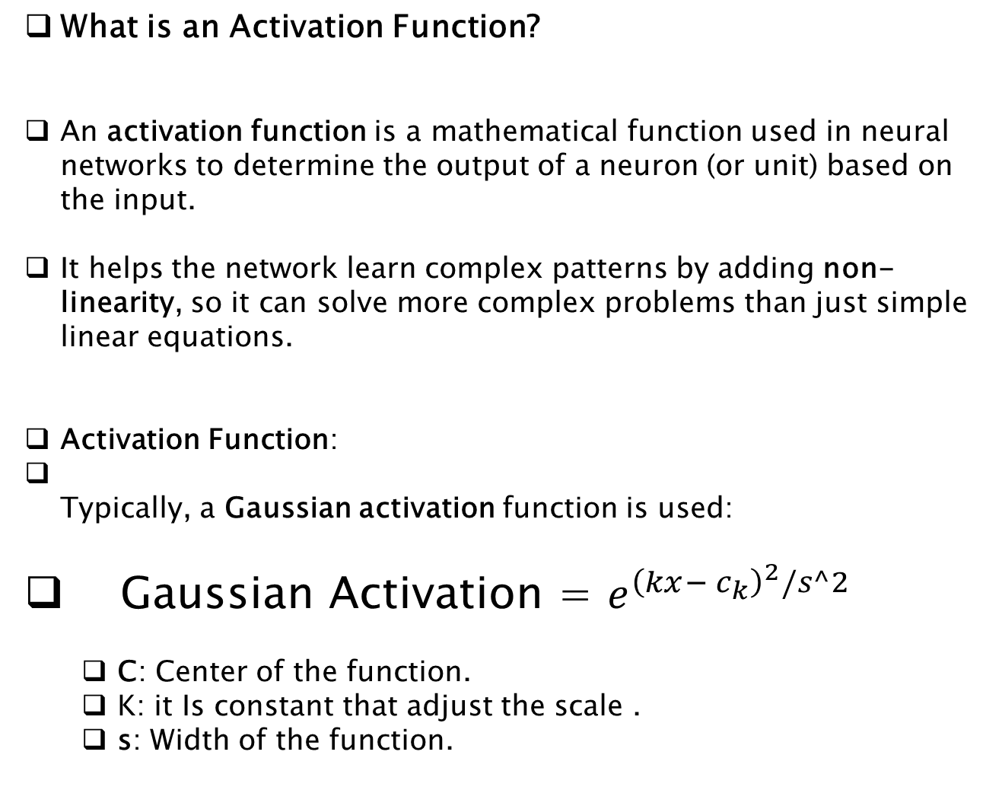
What is an Activation Function?
An activation function is a mathematical function used in neural networks to determine the output of a neuron (or unit) based on the input.
It helps the network learn complex patterns by adding non-linearity, so it can solve more complex problems than just simple linear equations.
Activation Function:
Typically, a Gaussian activation function is used:
Gaussian Activation = $e^{{\left(kx− c_{k}\right)}^{2}/s^2}$
C: Center of the function.
K: it Is constant that adjust the scale .
s: Width of the function.
Notes:
Real-life problems are complex: Most real-world tasks, like recognizing faces or understanding speech, are not simple. Non-linear functions help the network understand these complex patterns.
Makes better decisions: Without non-linearity, the network would only be able to draw straight lines and solve easy problems. Non-linearity allows the network to solve tougher problems by making more complex decisions.
Helps with deeper learning: By adding non-linearity, the network can build up more layers of knowledge and understand more complicated relationships in the data.
In short: Non-linear behavior helps to solve tough, real-world problems that linear models can’t handle.

Slide 4
First Phase learning For RBF network : Setting the Centers of RBF Units
In this phase, we focus on finding the "centers" of the Radial Basis Function (RBF) units.
These centers are crucial because they determine where each of the RBF units will focus in the data space.
In an RBF network, the centers are like "focus points" in the data.
Why are they important?
The centers tell the network where to focus when processing the data. If the center is in a busy area of the data, the RBF unit will be very active there, helping the network learn patterns in that part of the data.
Notes:
the benefit of setting centers in RBF networks is that they help the network focus on important areas of the data, improving learning and accuracy.

Slide 5
Second Phase - Setting Center Widths
Title: Second Phase of Learning Method: Setting Center Widths
Objective: Calculate and set the widths of the RBF units.
Explanation:
The center width controls how much data each center influences.
To calculate the width, use techniques like the p-nearest neighbor rule.
p-nearest neighbor rule finds the average distance of the nearest p neighbors to a center, helping define how spread out each center is.
What are center widths?
They determine the "influence area" of a center.
How are they calculated?
By checking the distance to nearby data points.
p-nearest neighbor rule: Average distance of the p-nearest points.
Notes:
In the second phase, our goal is to set the widths of the centers we defined in the first phase.“How are Center Widths Calculated?:To calculate the widths, we use techniques like the p-nearest neighbor rule."

Slide 6
Third Phase - Calculating Weights
Title: Third Phase of Learning Method: Calculating Weights
Objective: Calculate the weights between the hidden layer and output layer.
Explanation:
In the third phase, the focus is on adjusting the weights that connect the RBF units (hidden layer) to the output.
These weights are calculated using a method called OSD (Optimum Steepest Descent).
You can use SVD (Singular Value Decomposition) to initialize weights and speed up convergence.
What are weights?
Weights represent the strength of the connection between the hidden and output layers.
How are weights calculated?
Using the Optimum Steepest Descent (OSD) algorithm.
Initial weights can be computed using Singular Value Decomposition (SVD).

